Slide 1
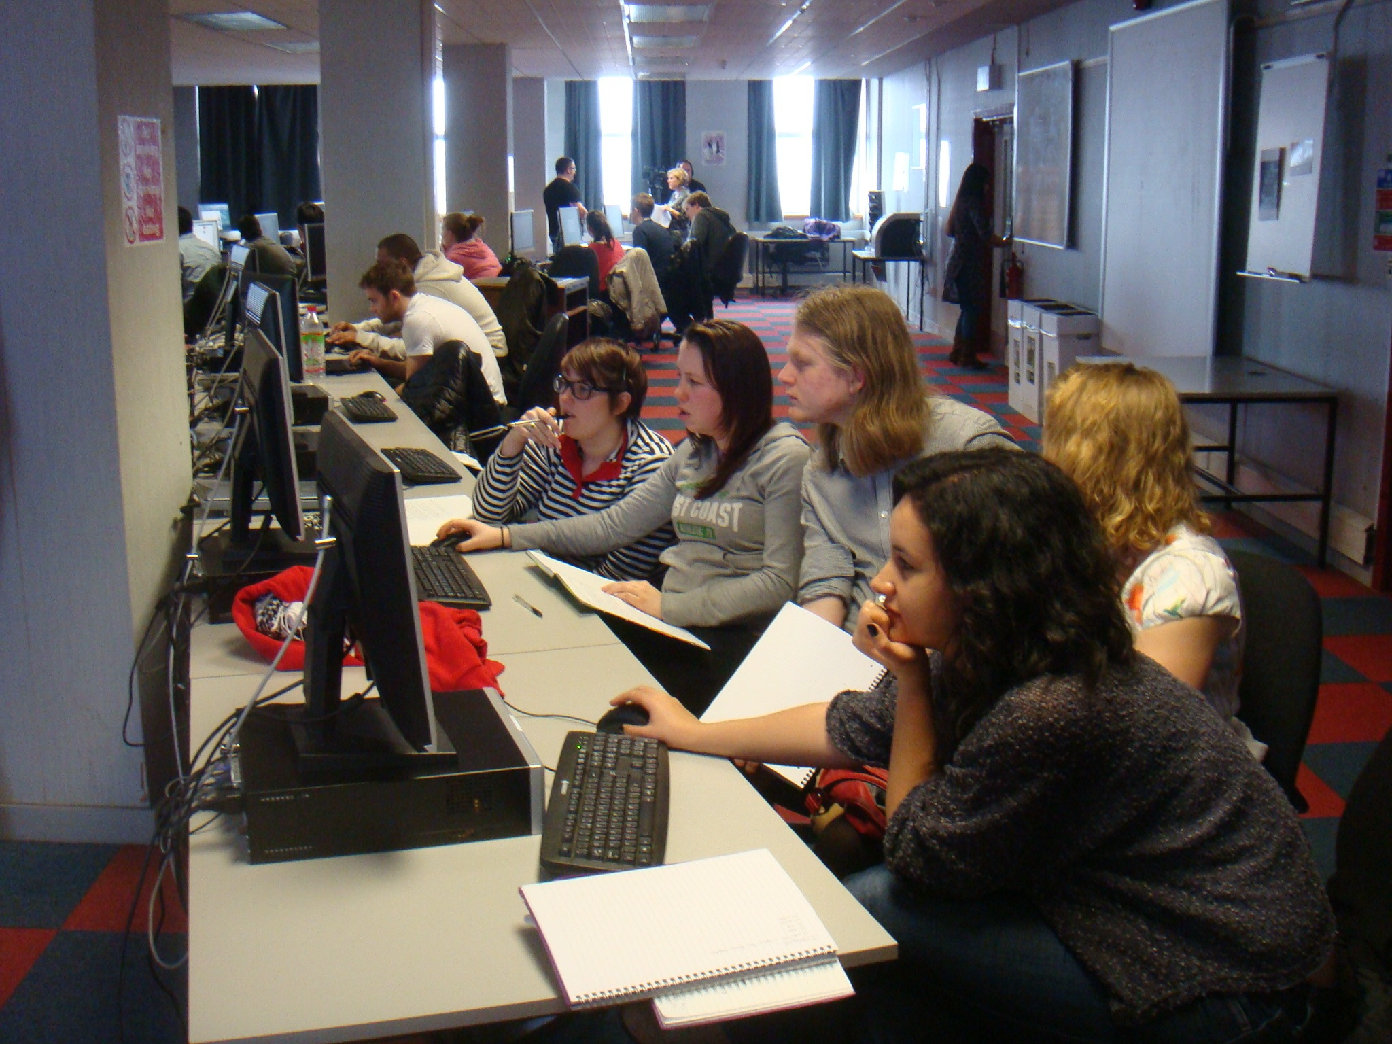
TextLab Introducing Students to Methods of Digital Humanities & Text Analysis
Richard J. Whitt, Heather Froehlich, Jonathan Hope, Anouk Lang
Visualizing English Print from 1470-1800
Collaborative project between University of Wisconsin-Madison (USA), University of Strathclyde (UK), and Folger Shakespeare Library (USA)
Funded by the Andrew W. Mellon Foundation
Computer-aided analysis of texts allows us to better understand, classify, and quantify large numbers of texts in ways which were not previously available.
A combination of newly developed software packages designed for literary-linguistic analysis
WordHoard
DocuScope
LATice
Through conducting a mathematically based analysis using statistical analysis programmes (like R or JMP)
Asks questions such as:
What makes some texts more or less similar to other texts?
What do specific genres of written language have in common?
Where did the novel come from?
What are the functional properties of literary language?
The software packages
WordHoard
Asks the question “what happens when we compare one (or more) text(s) to another group of one (or more) text(s)?”
Statistical (log-likelihood) analysis of words and lemma
Allows user to see words in use in context
DocuScope
A rhetorical analysis programme that tags words and collocates for their function in a text
Each tag is known as a LAT (Language Action Type)
LATs are underlined and colour-coded
LATice
Uses DocuScope output to generate a heat map
The heatmap shows similarities and differences among texts using dark and light colour shading, respectively
This is based on LAT frequency in the texts
TextLab
As part of the Vertically Integrated Projects (VIP) initiative, students from a variety of backgrounds—both year and major—are placed into groups to foster interdisciplinary collaboration (between English and Computer and Information Science majors, in this instance)
Each group is assigned one of Shakespeare’s plays and given the task of performing a linguistic analysis of the play by using and evaluating software tools designed for such purposes (see above)
Students log their progress both individually (in a notebook) and as a group (on a wiki)
Students’ findings, especially critiques of the software programmes, will be reported back to the “Visualizing English Print” project team
These findings will also be published on the website guide to the Language of Early Modern Drama (LEMD)
Below are some of each group’s results

